Slide 1
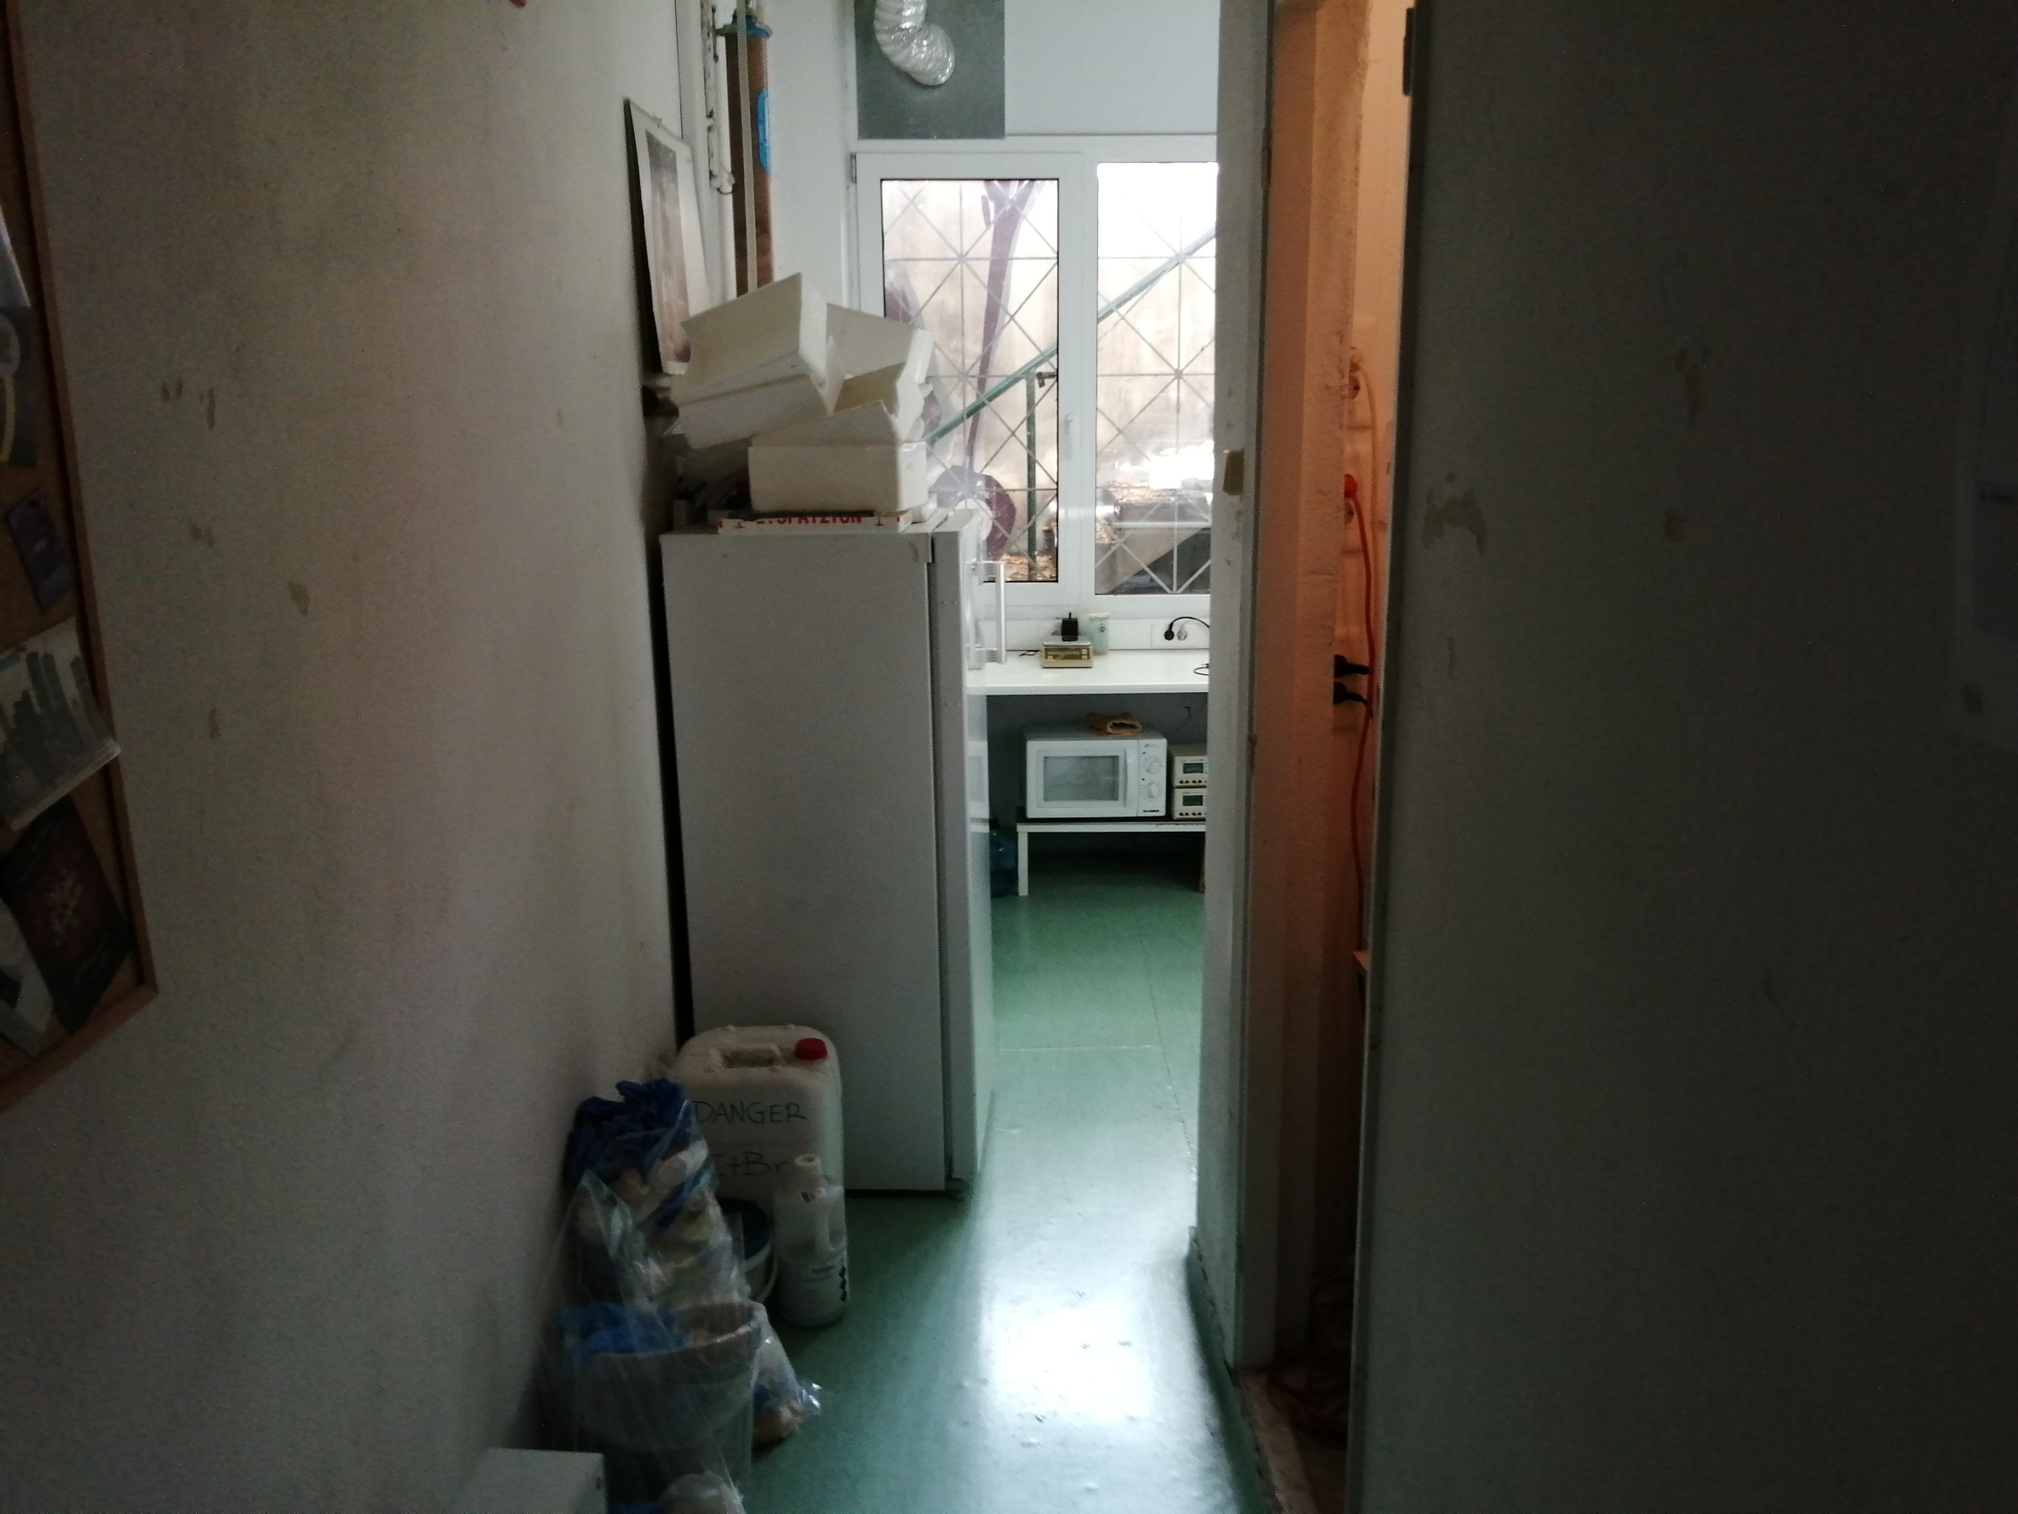
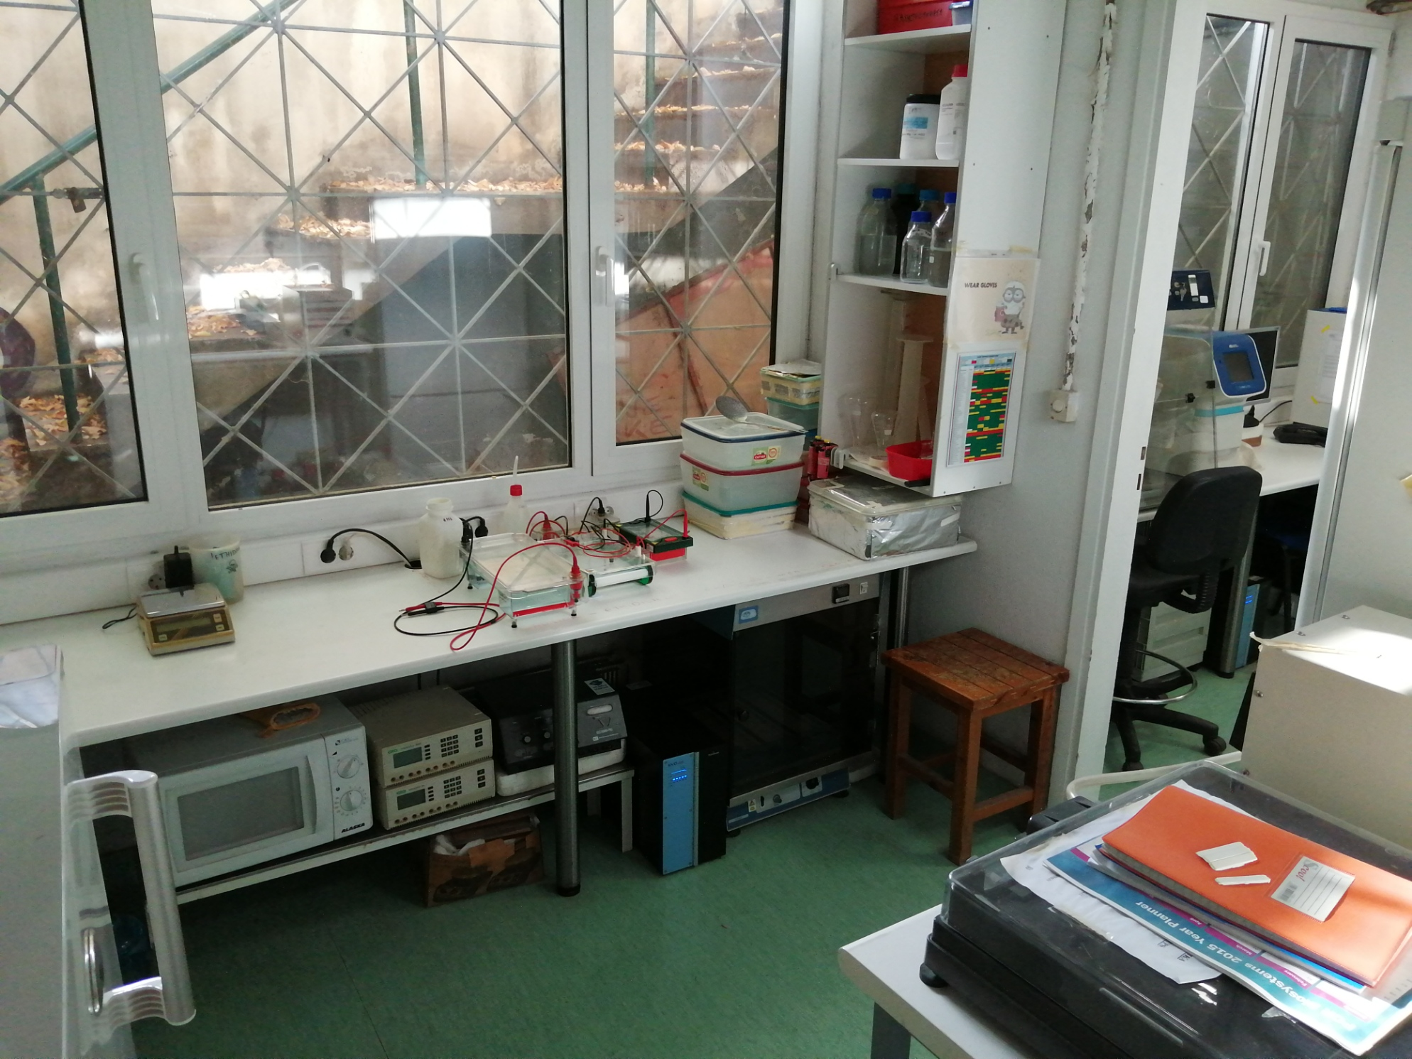
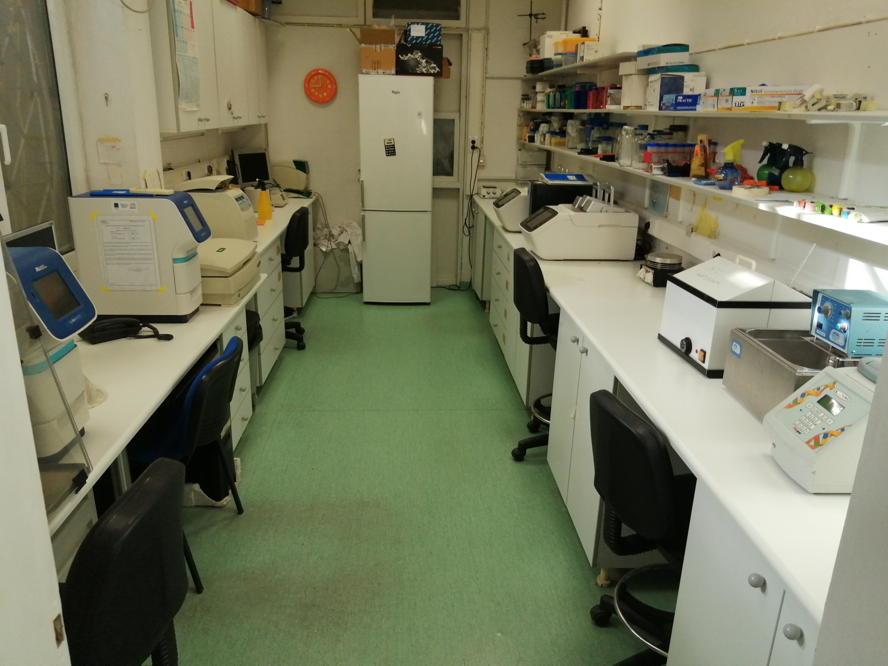
The molecular biology laboratory

Slide 2
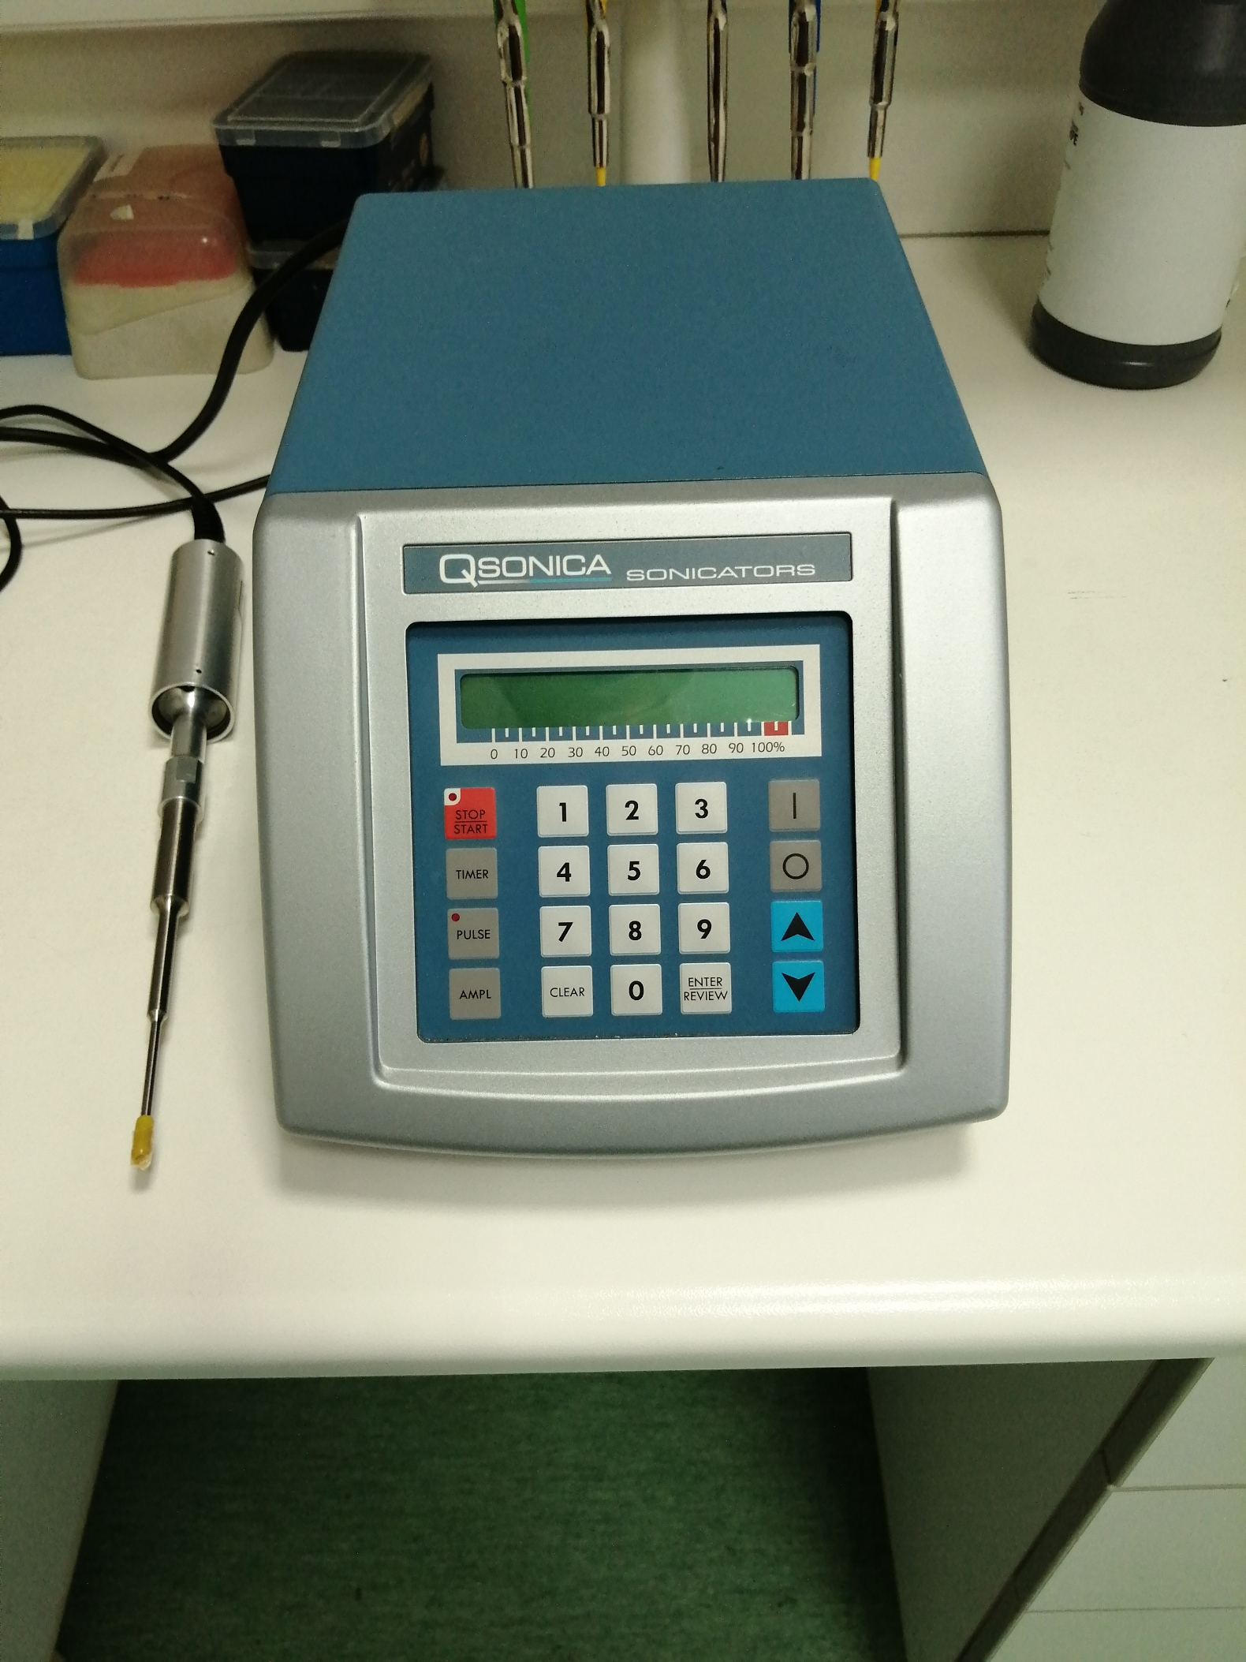
equipment
Sonicating device equipped with probe, ideal for mixing, emulsification and disruption of cell cultures

Slide 3
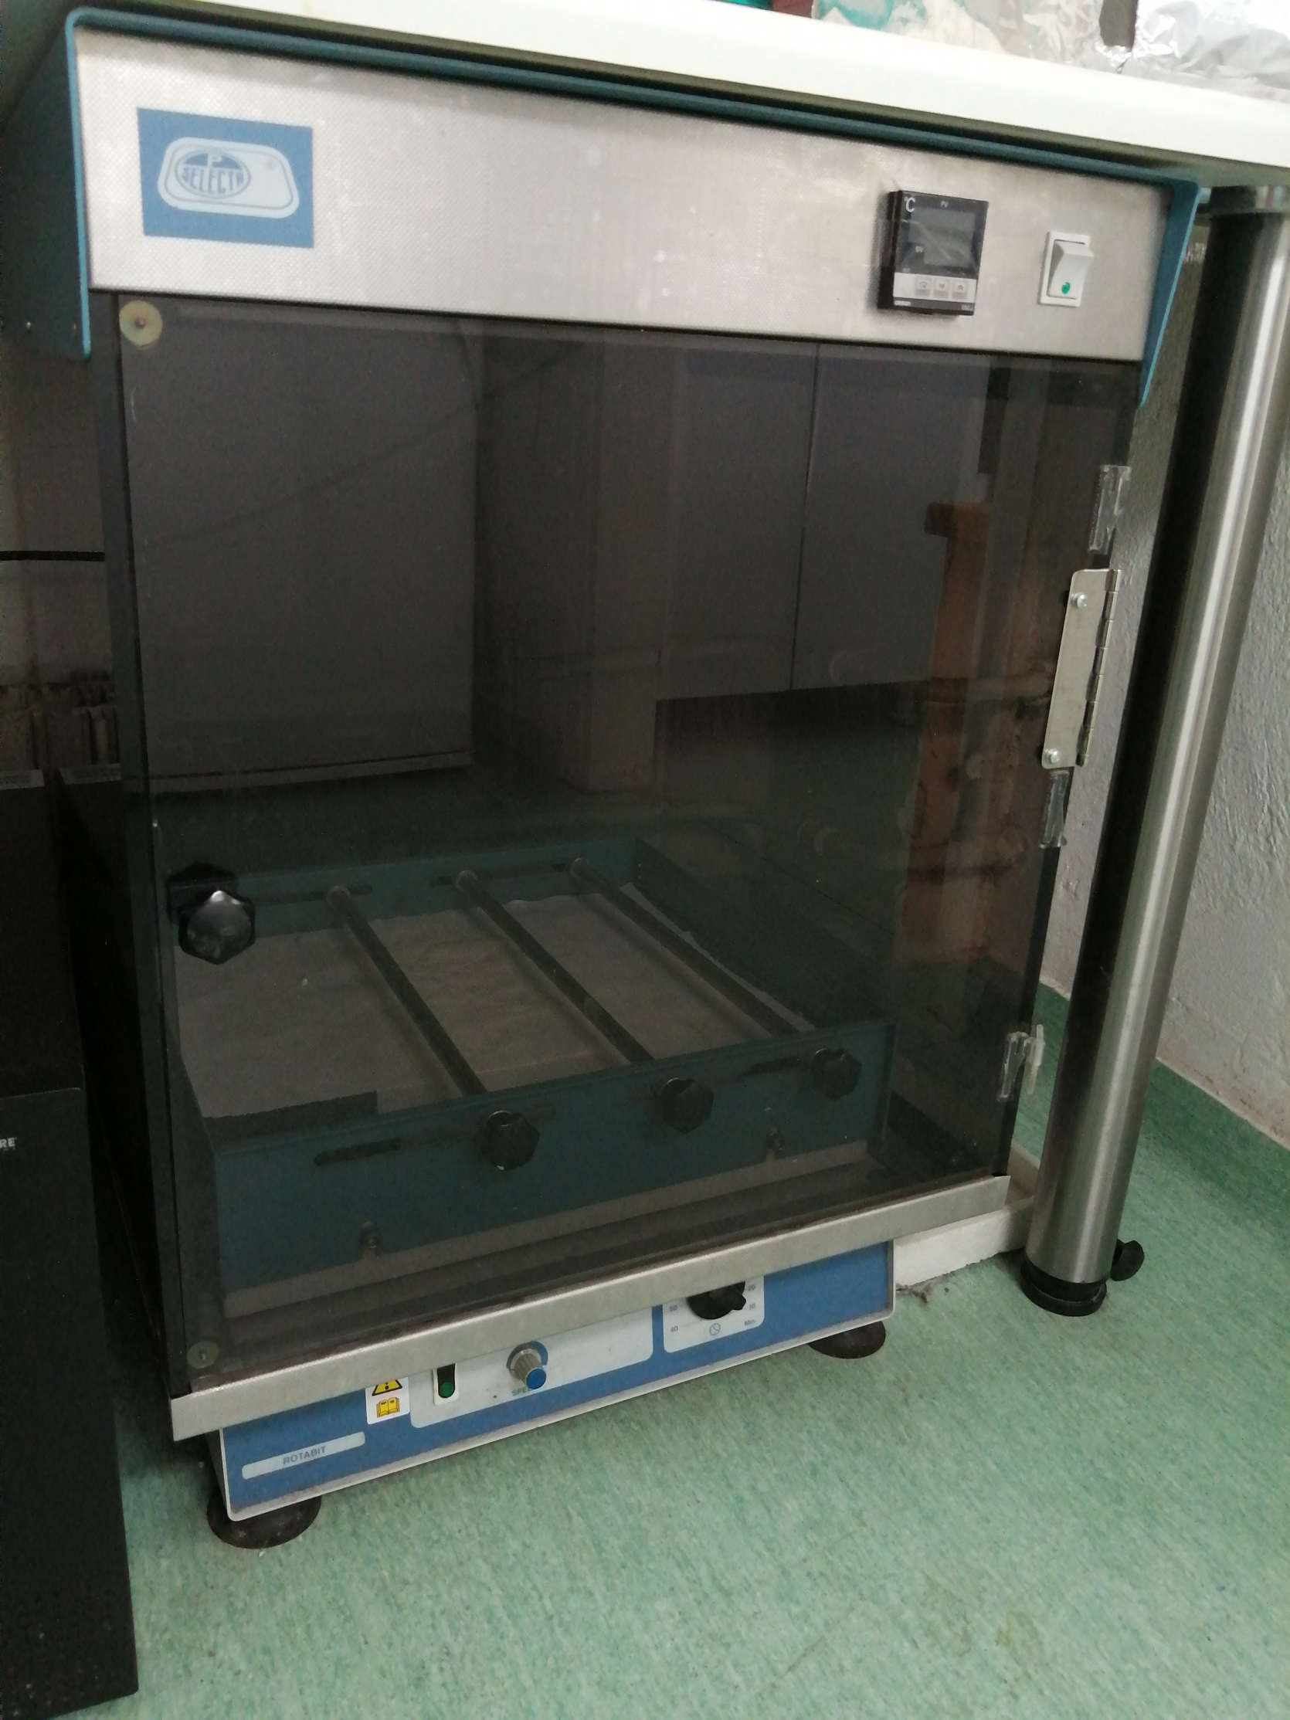
Shaking incubator, for any application requiring temperature control and shaking, such as enzymatic reactions, microorganism cultivation etc.

Slide 4
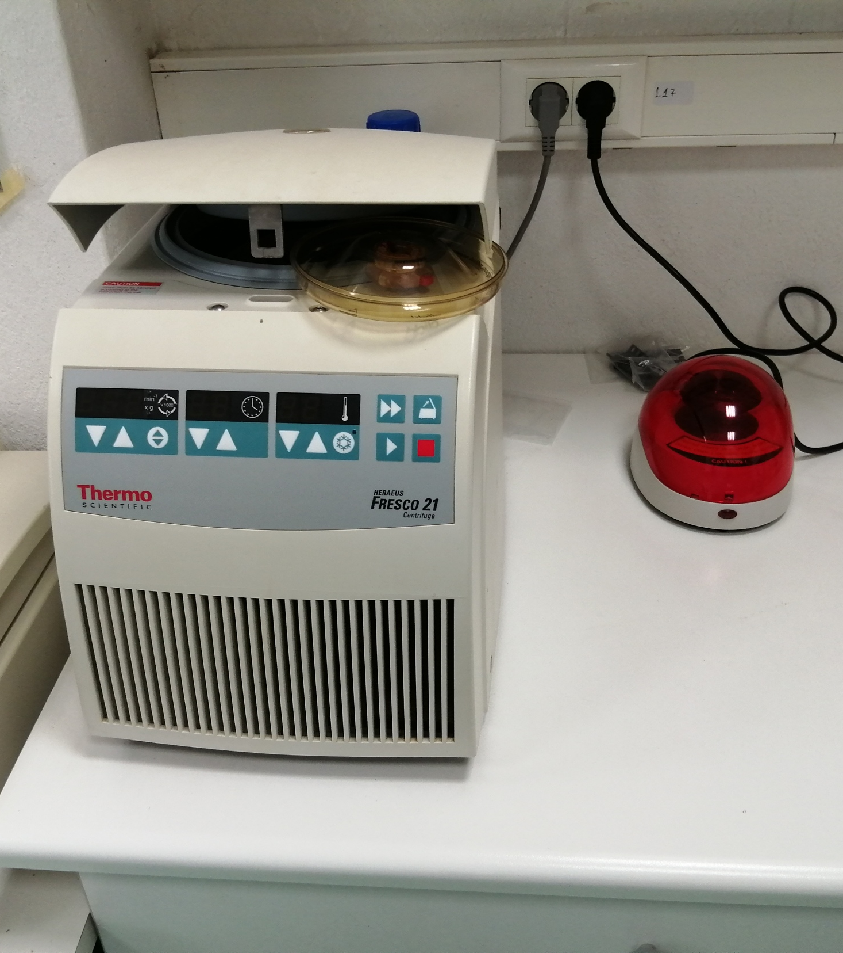
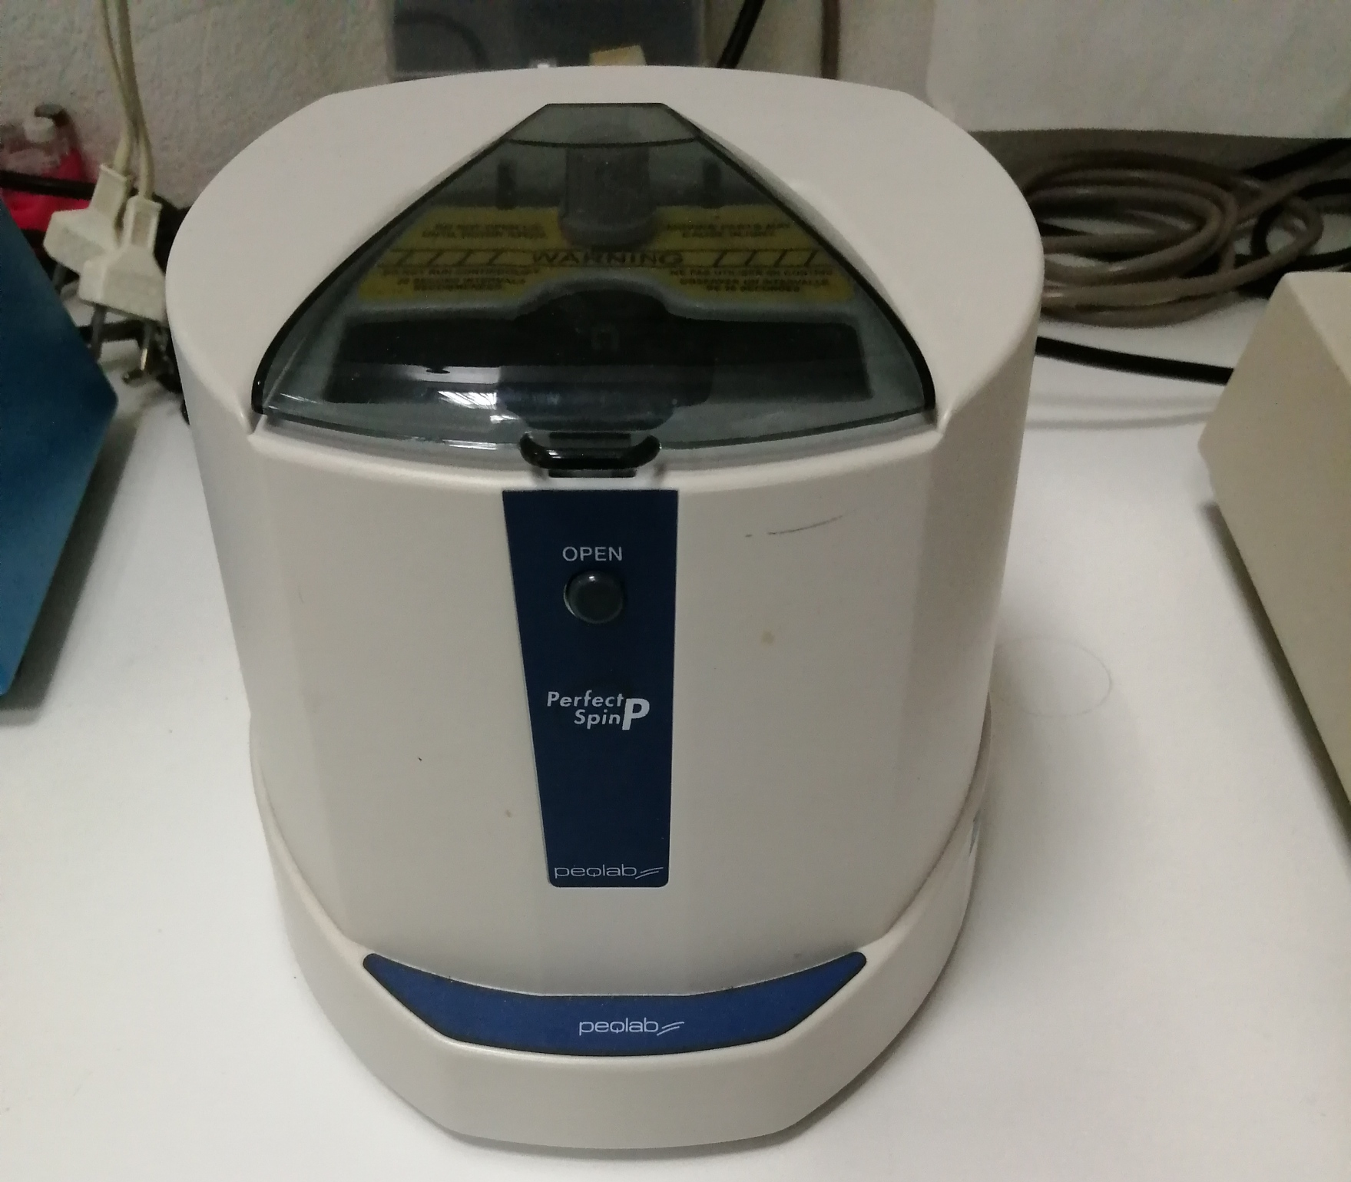
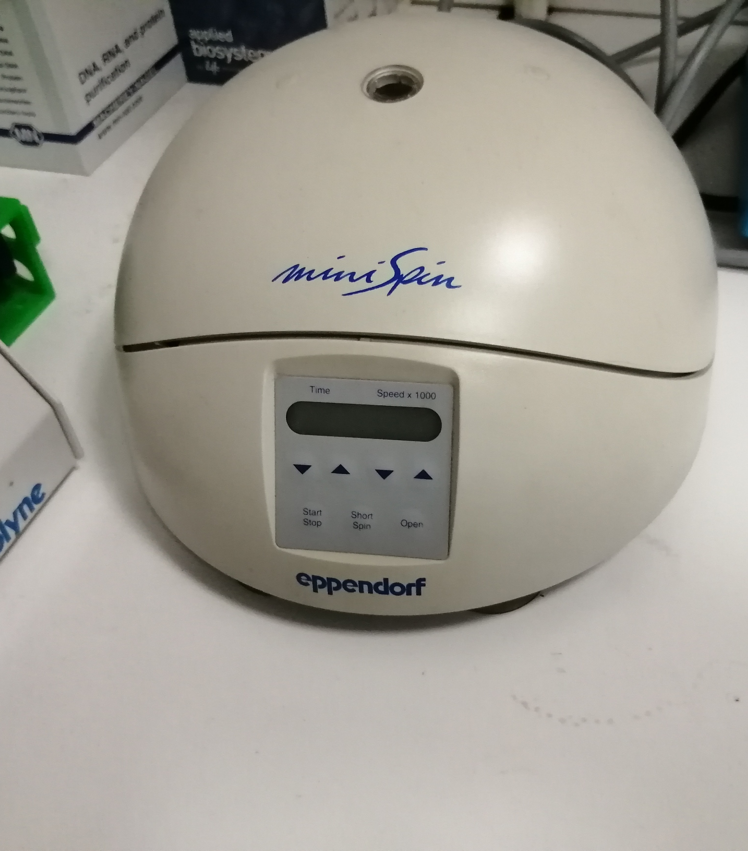
Centrifuges of different sizes and capabilities, depending on the application

Slide 5
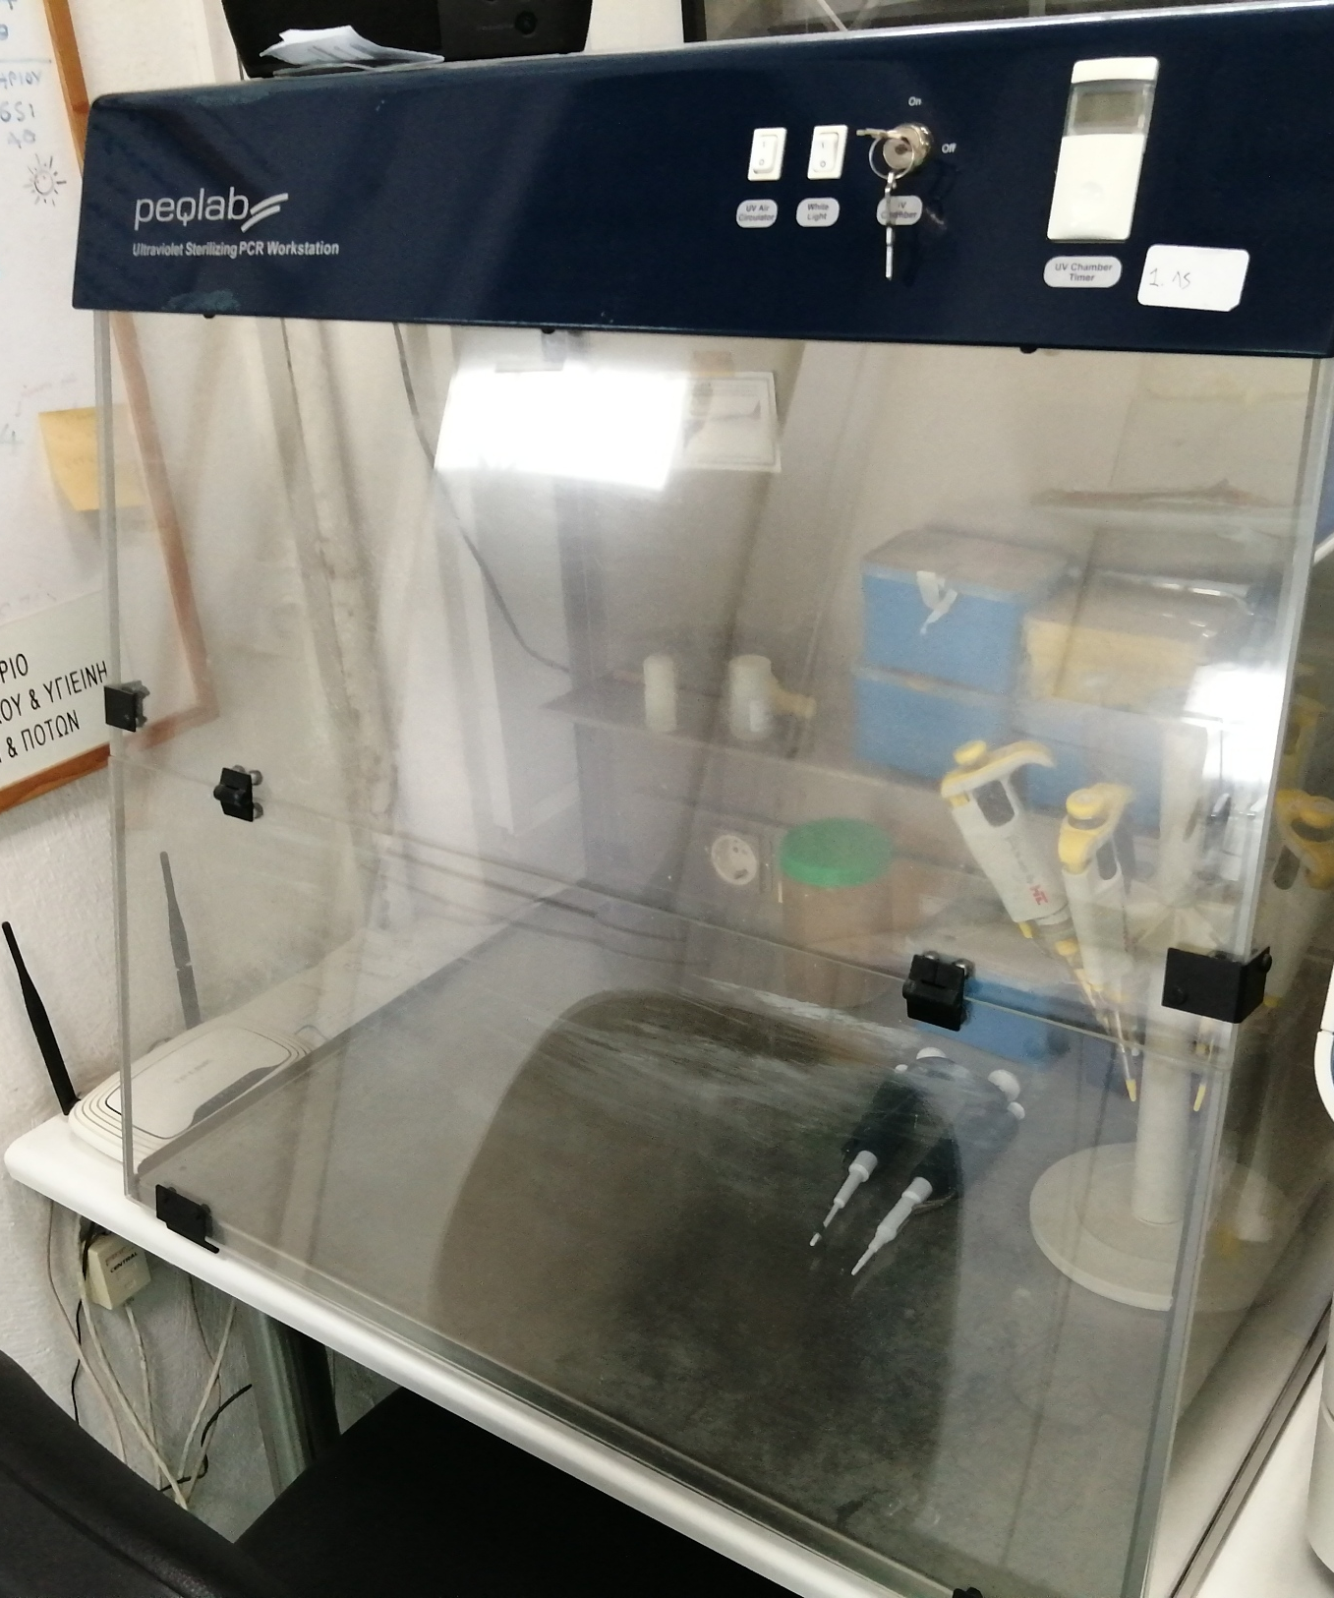
Working station equipped with air filters and UV lamps for effective control during mixing of ingredients and setting up of PCR reactions of any format

Slide 6
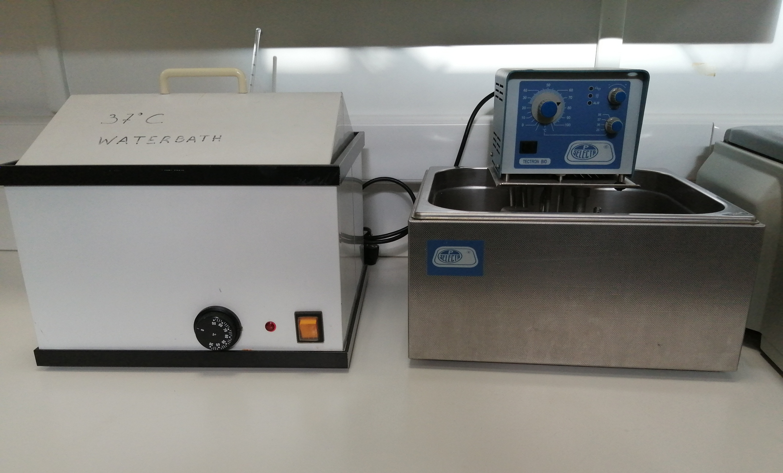
Water baths for applications requiring temperature control, such as enzymatic reactions

Slide 7
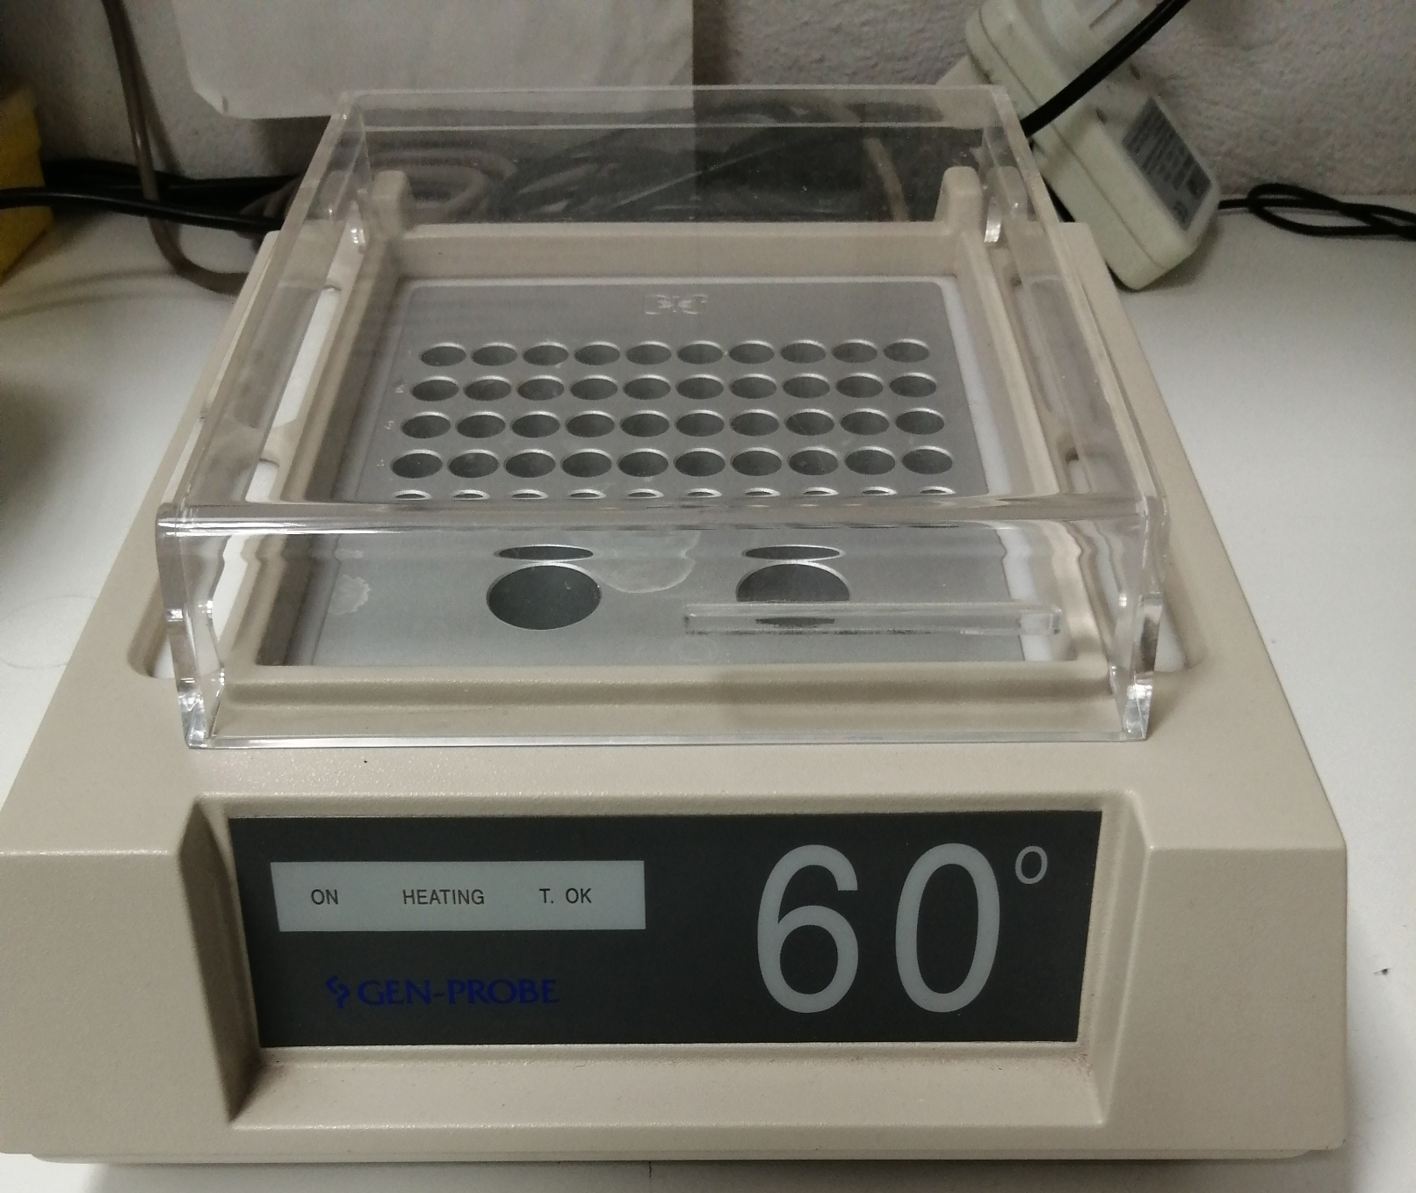
Thermoblocks for applications requiring temperature control, such as enzymatic reactions

Slide 8
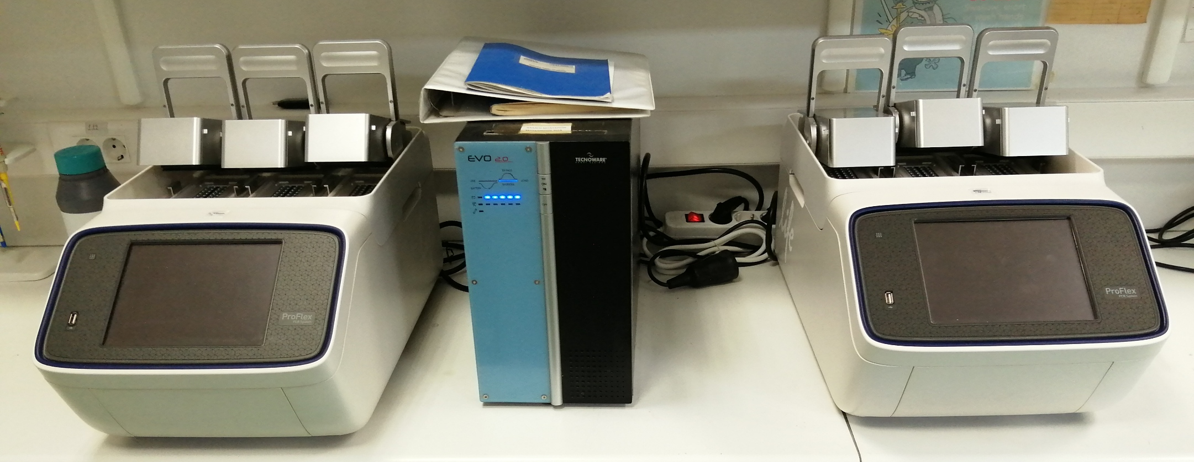
Thermocyclers equipped with 3 independently controlled heads of 32 positions each

Slide 9
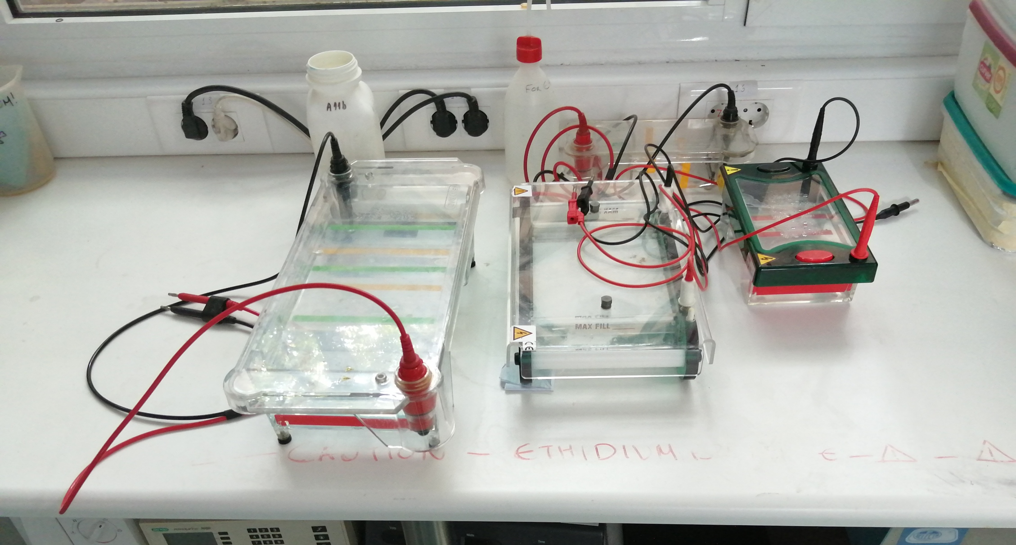
Horizontal gel electrophoresis equipment, at different sizes, ideal for agarose gel applications

Slide 10
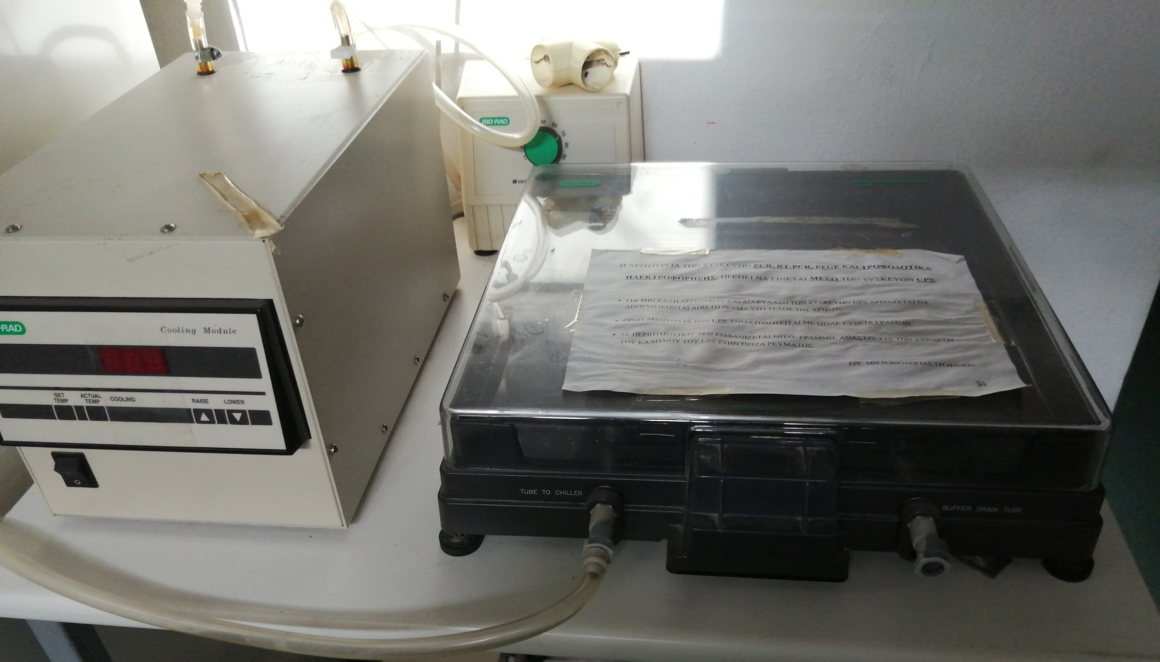
Pulsed-Field Gel Electrophoresis equipment

Slide 11
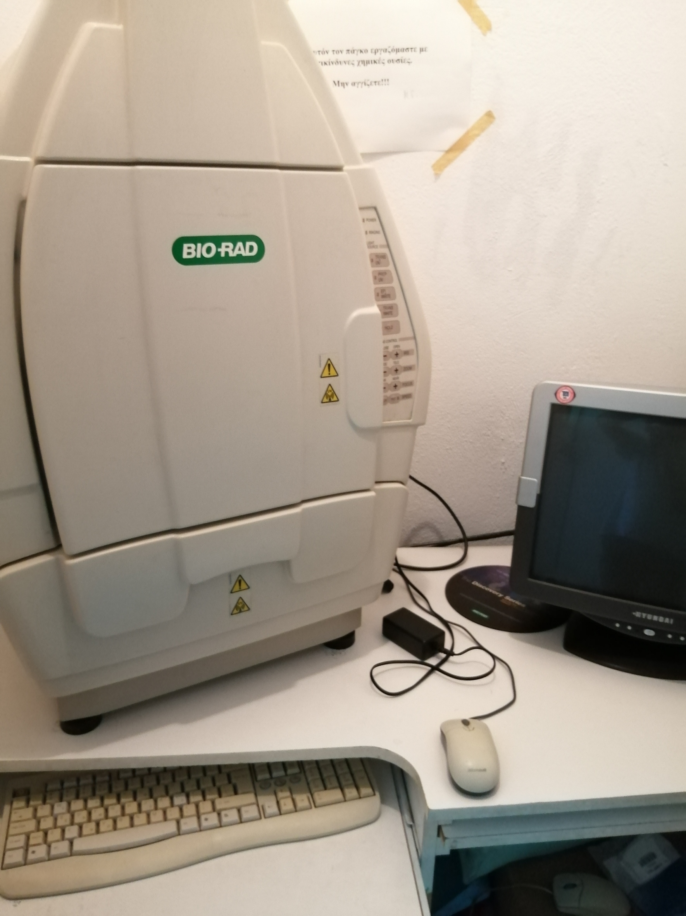
Gel documentation system, ideal for applications involving UV excitation and emission at wavelenghts of the visible range

Slide 12
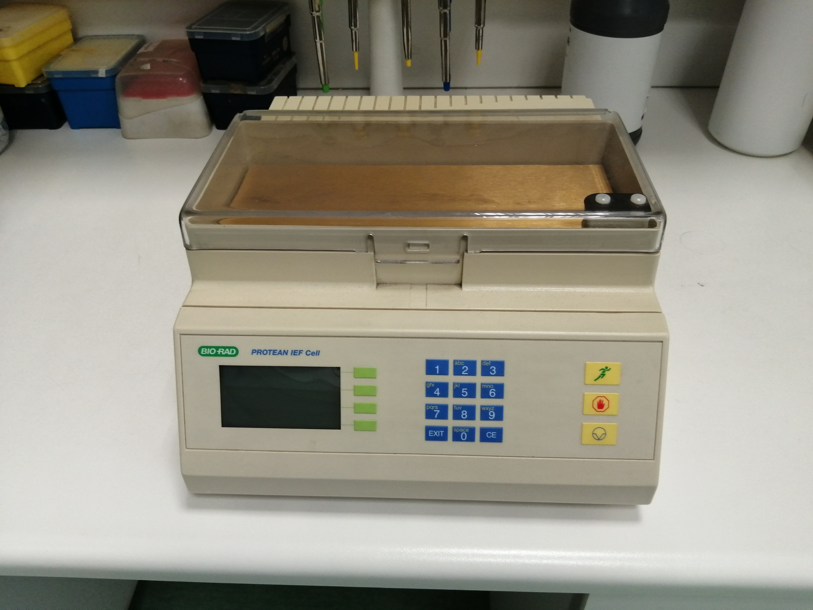
Isoelectric focusing equipment ideal for differentiating proteins according to their isoelectric point

Slide 13
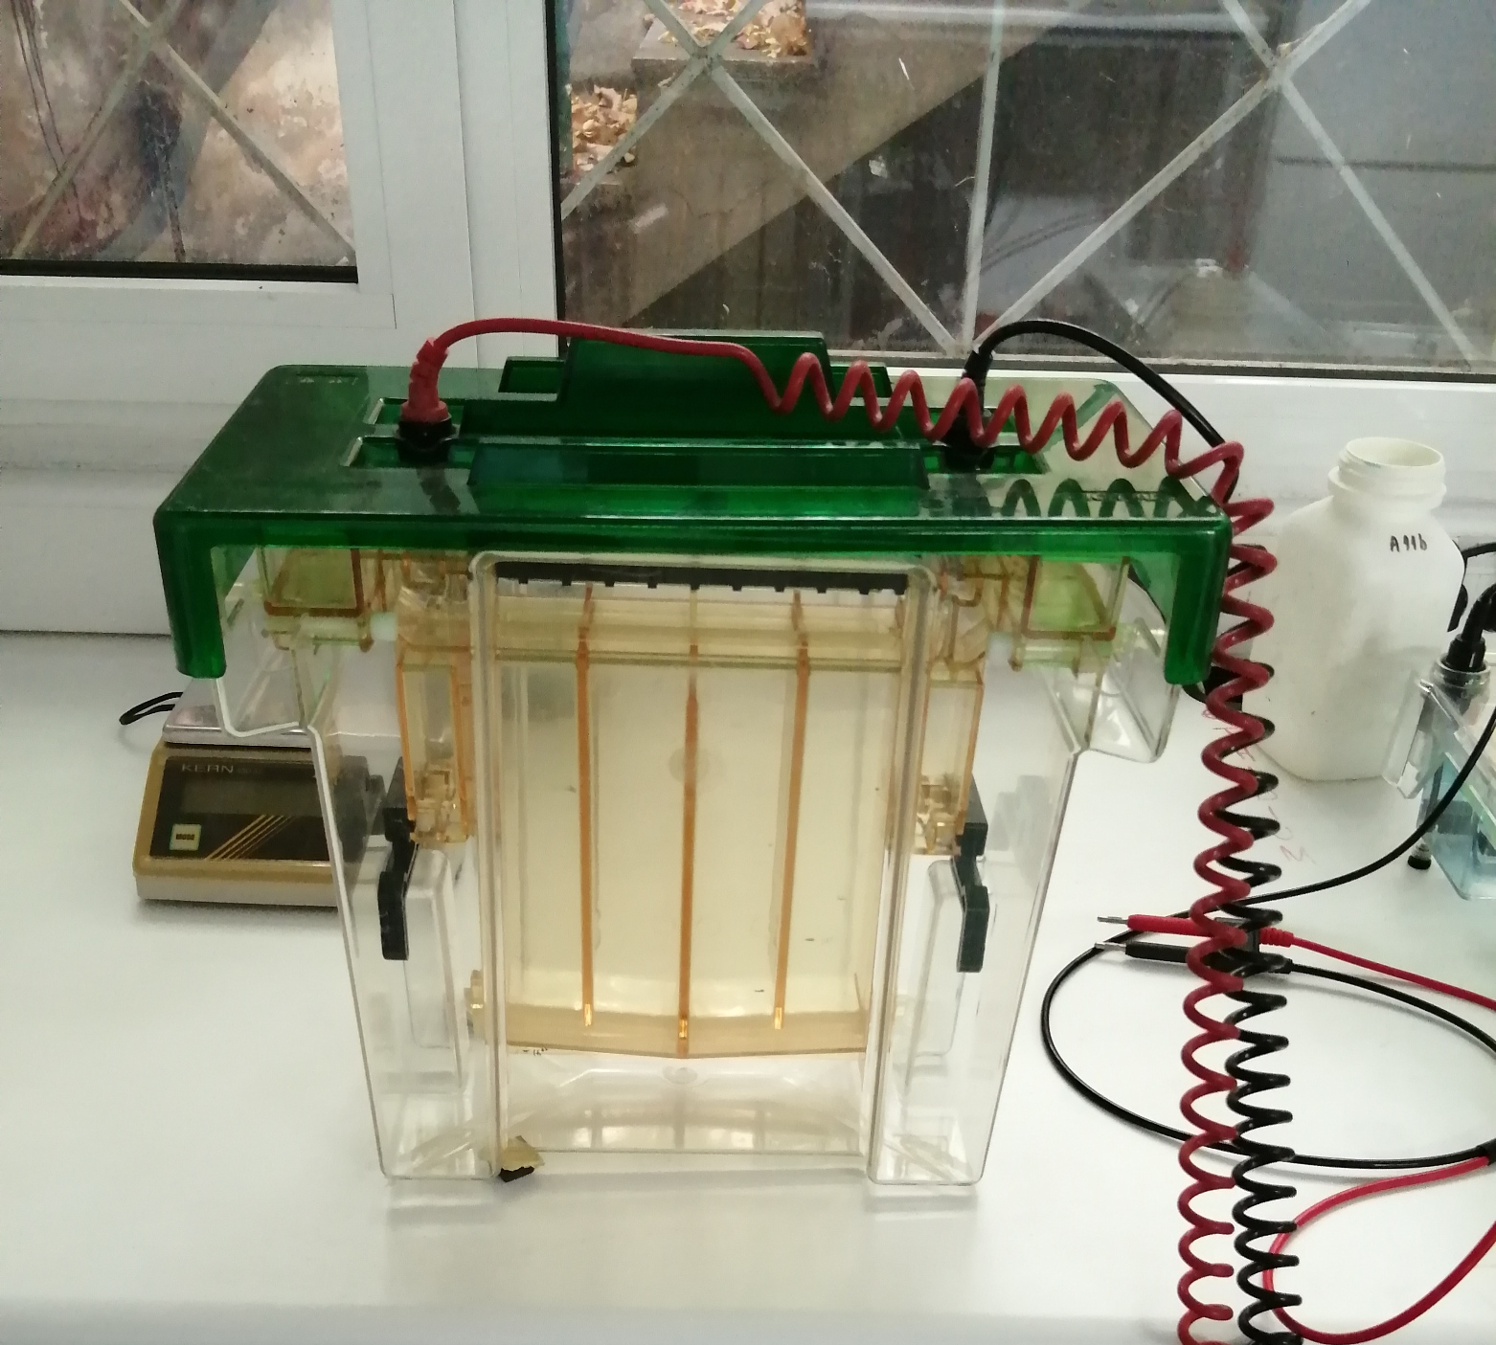
Vertical electrophoresis equipment, ideal for applications involving polyacrylamide gel electrophoresis

Slide 14
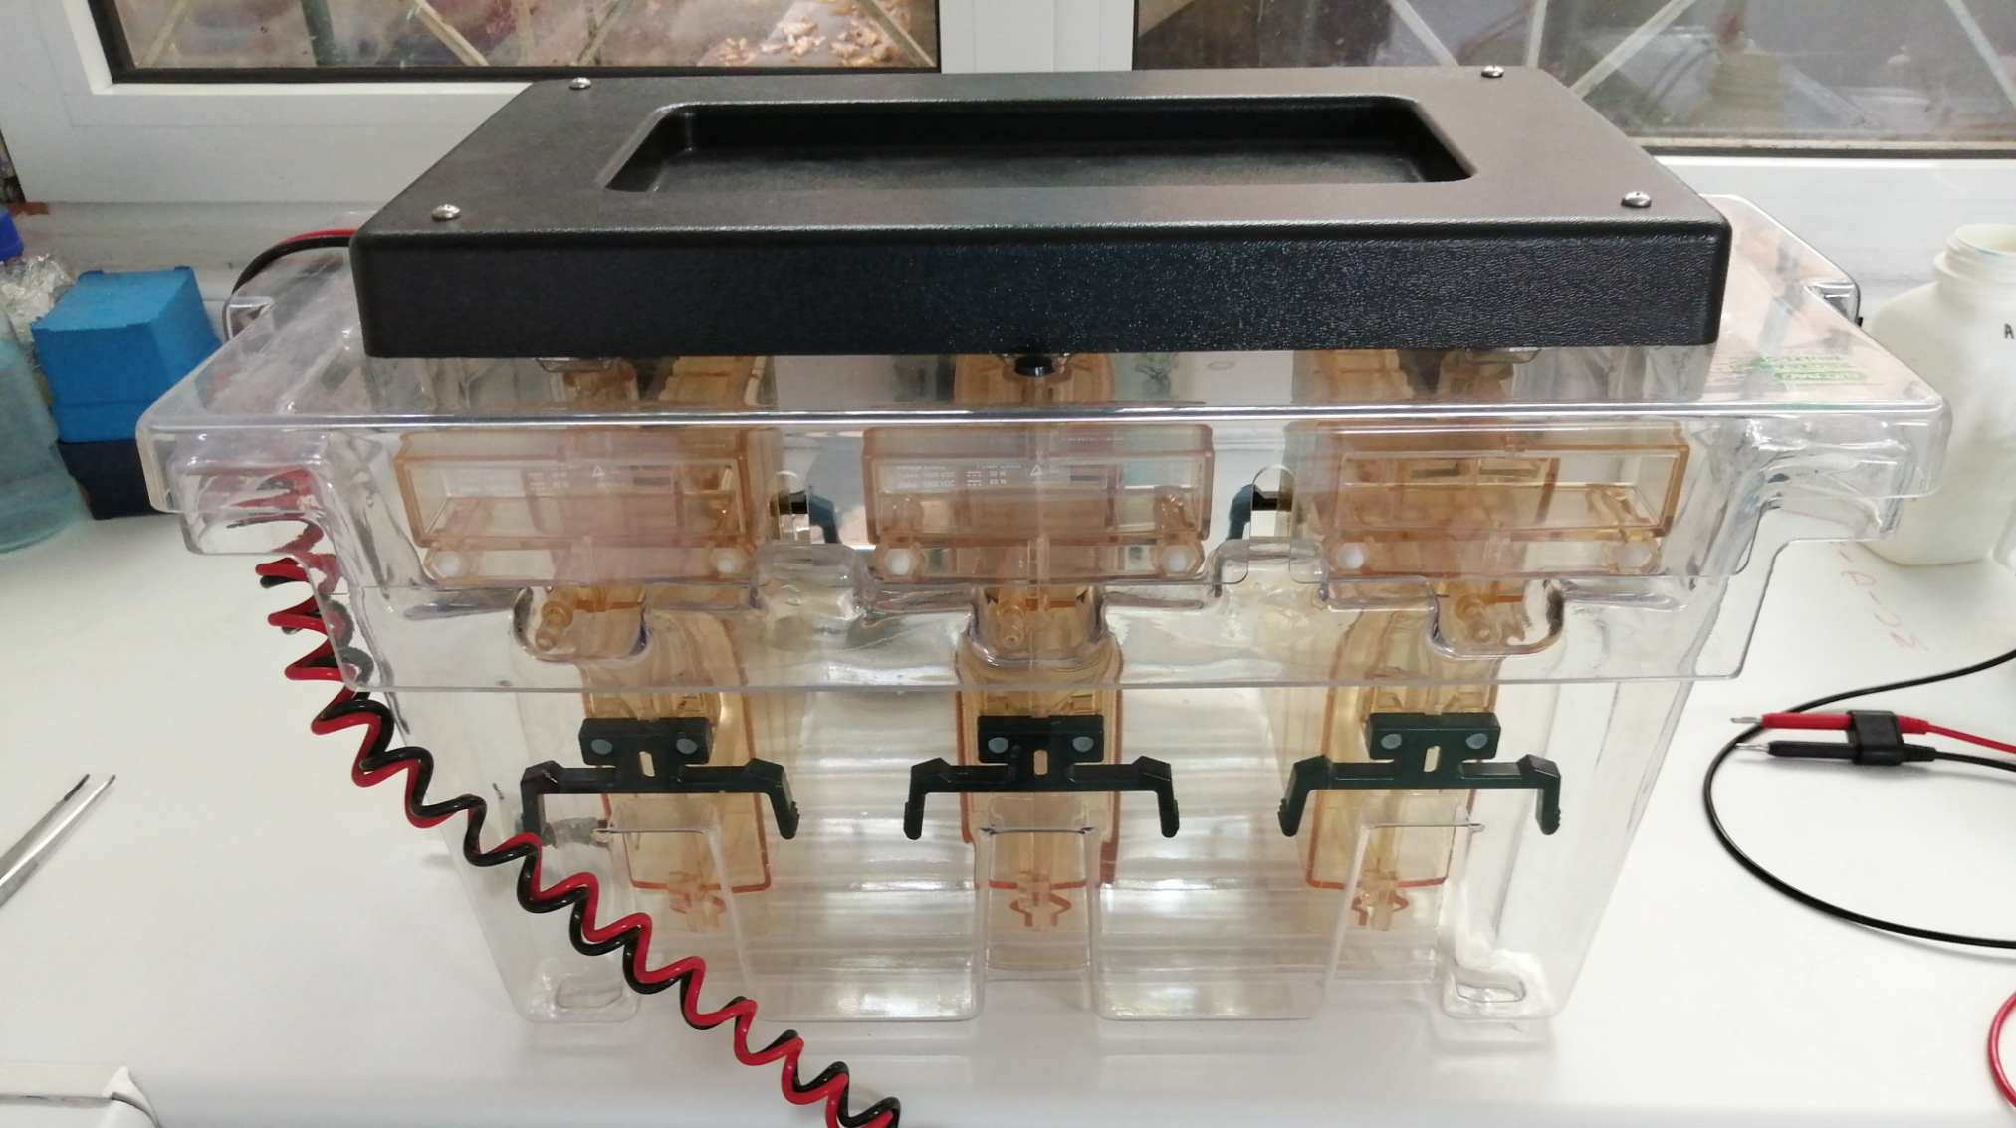
Multiple vertical gel electrophoresis system, ideal for applications involving polyacrylamide gel electrophoresis and the need for multiple runs

Slide 15
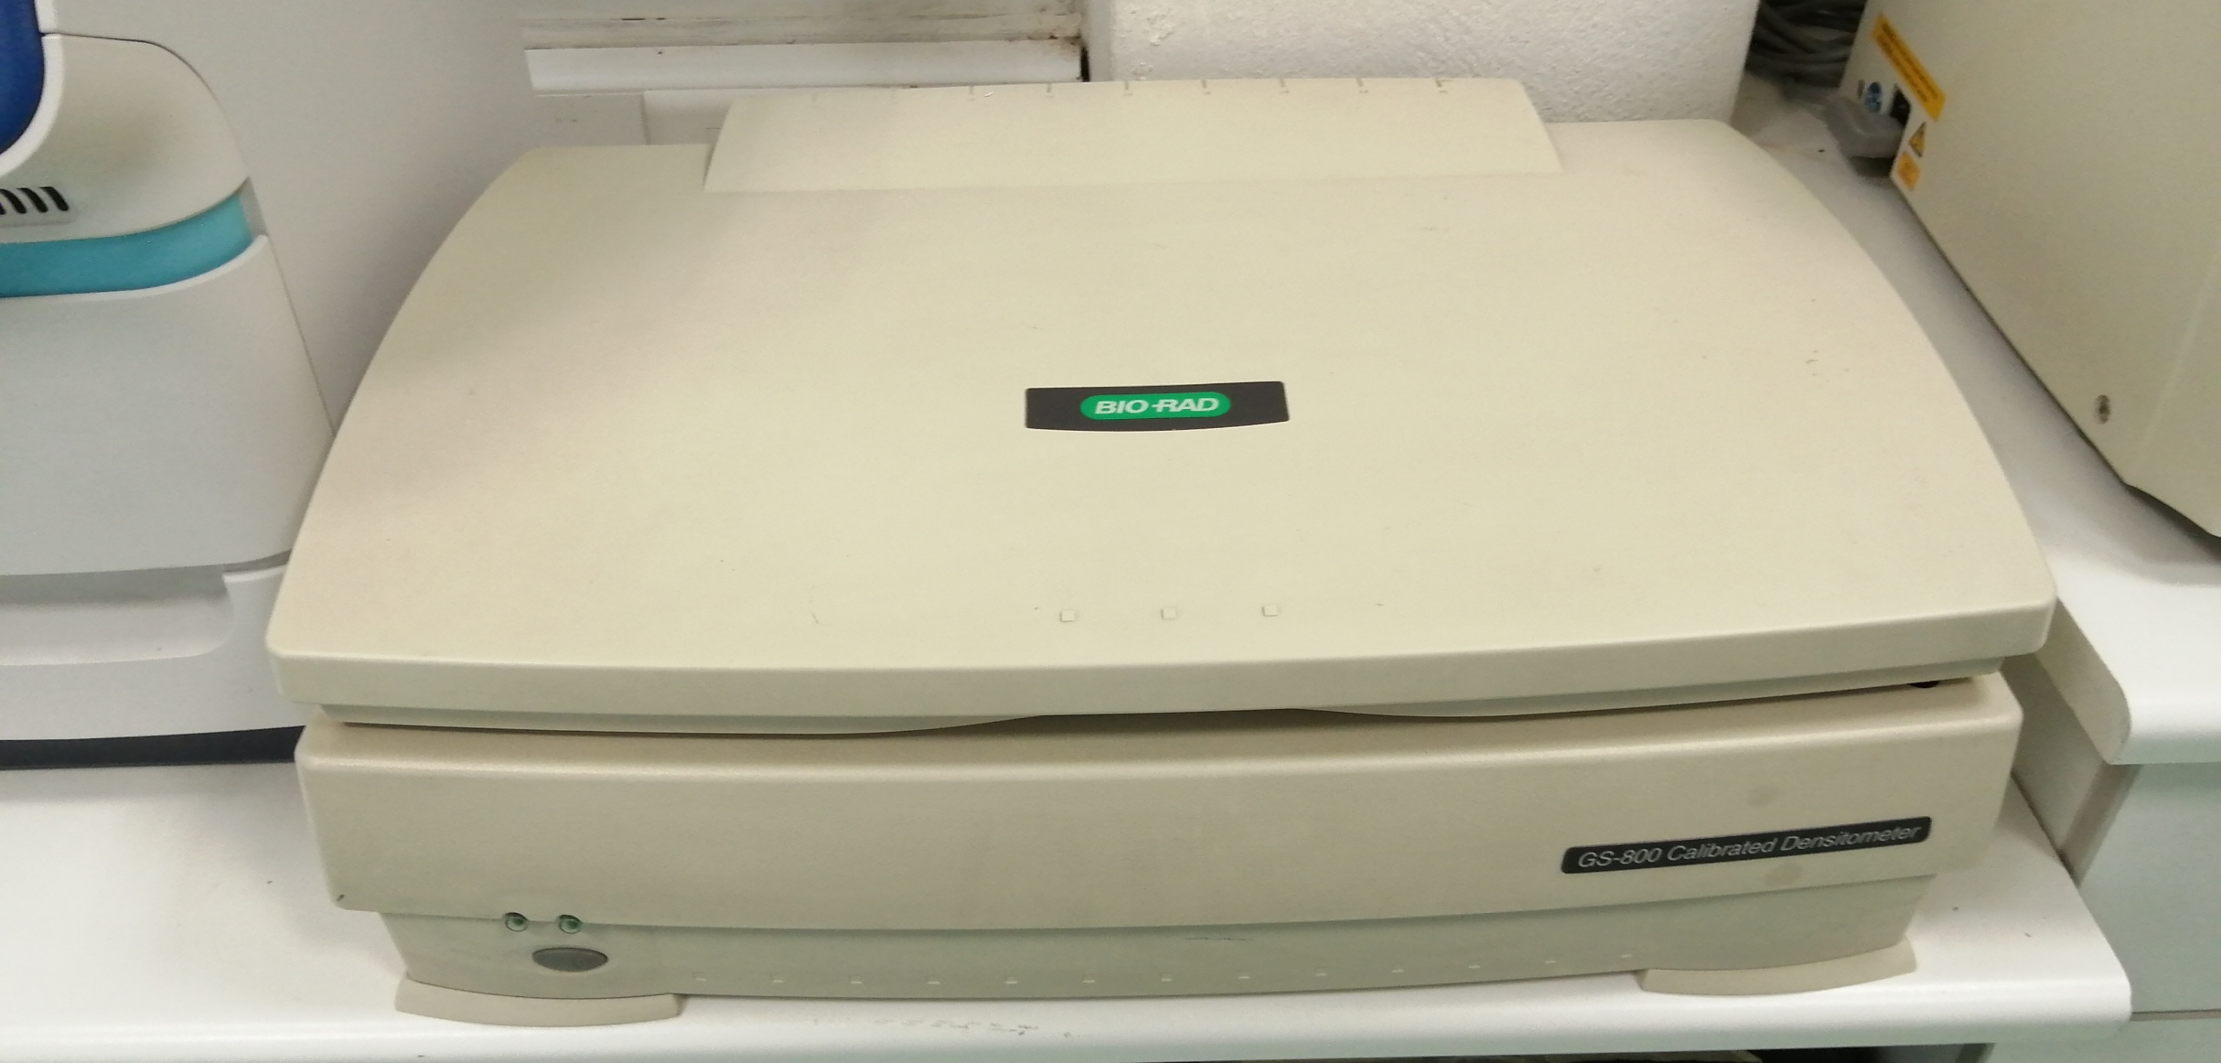
Gel documentation system for applications requiring calibrated densitometric evaluation

Slide 16
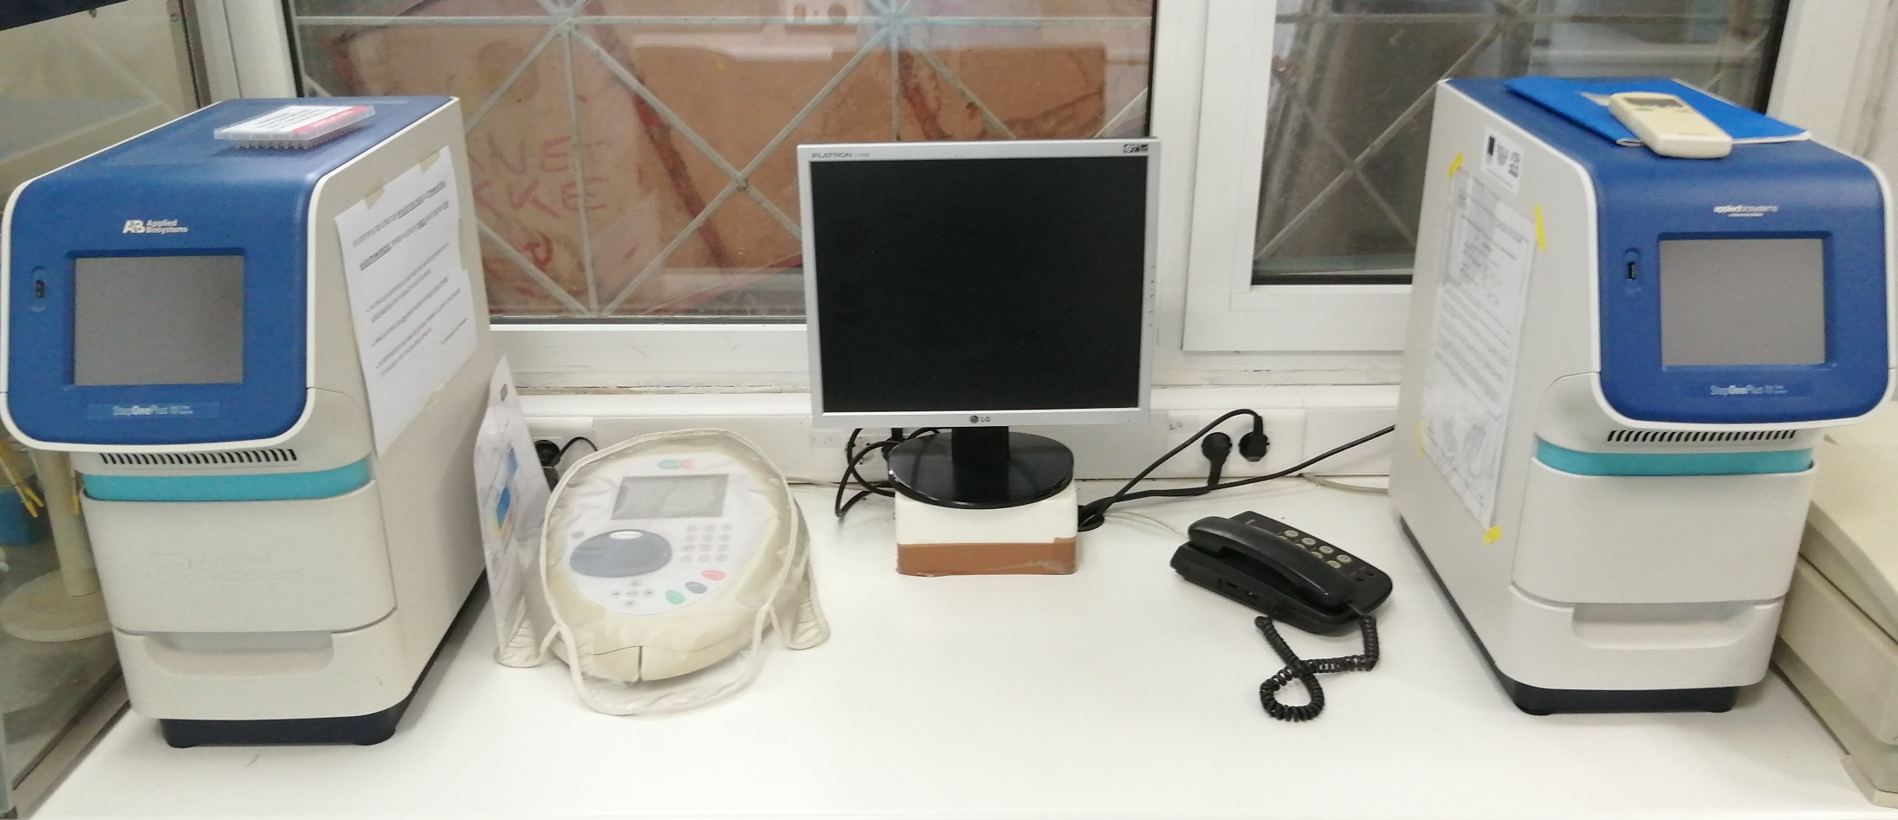
Real time PCR systems, ideal for gene expression assessment and analyses involving the quantification of amplicon generation

Slide 17
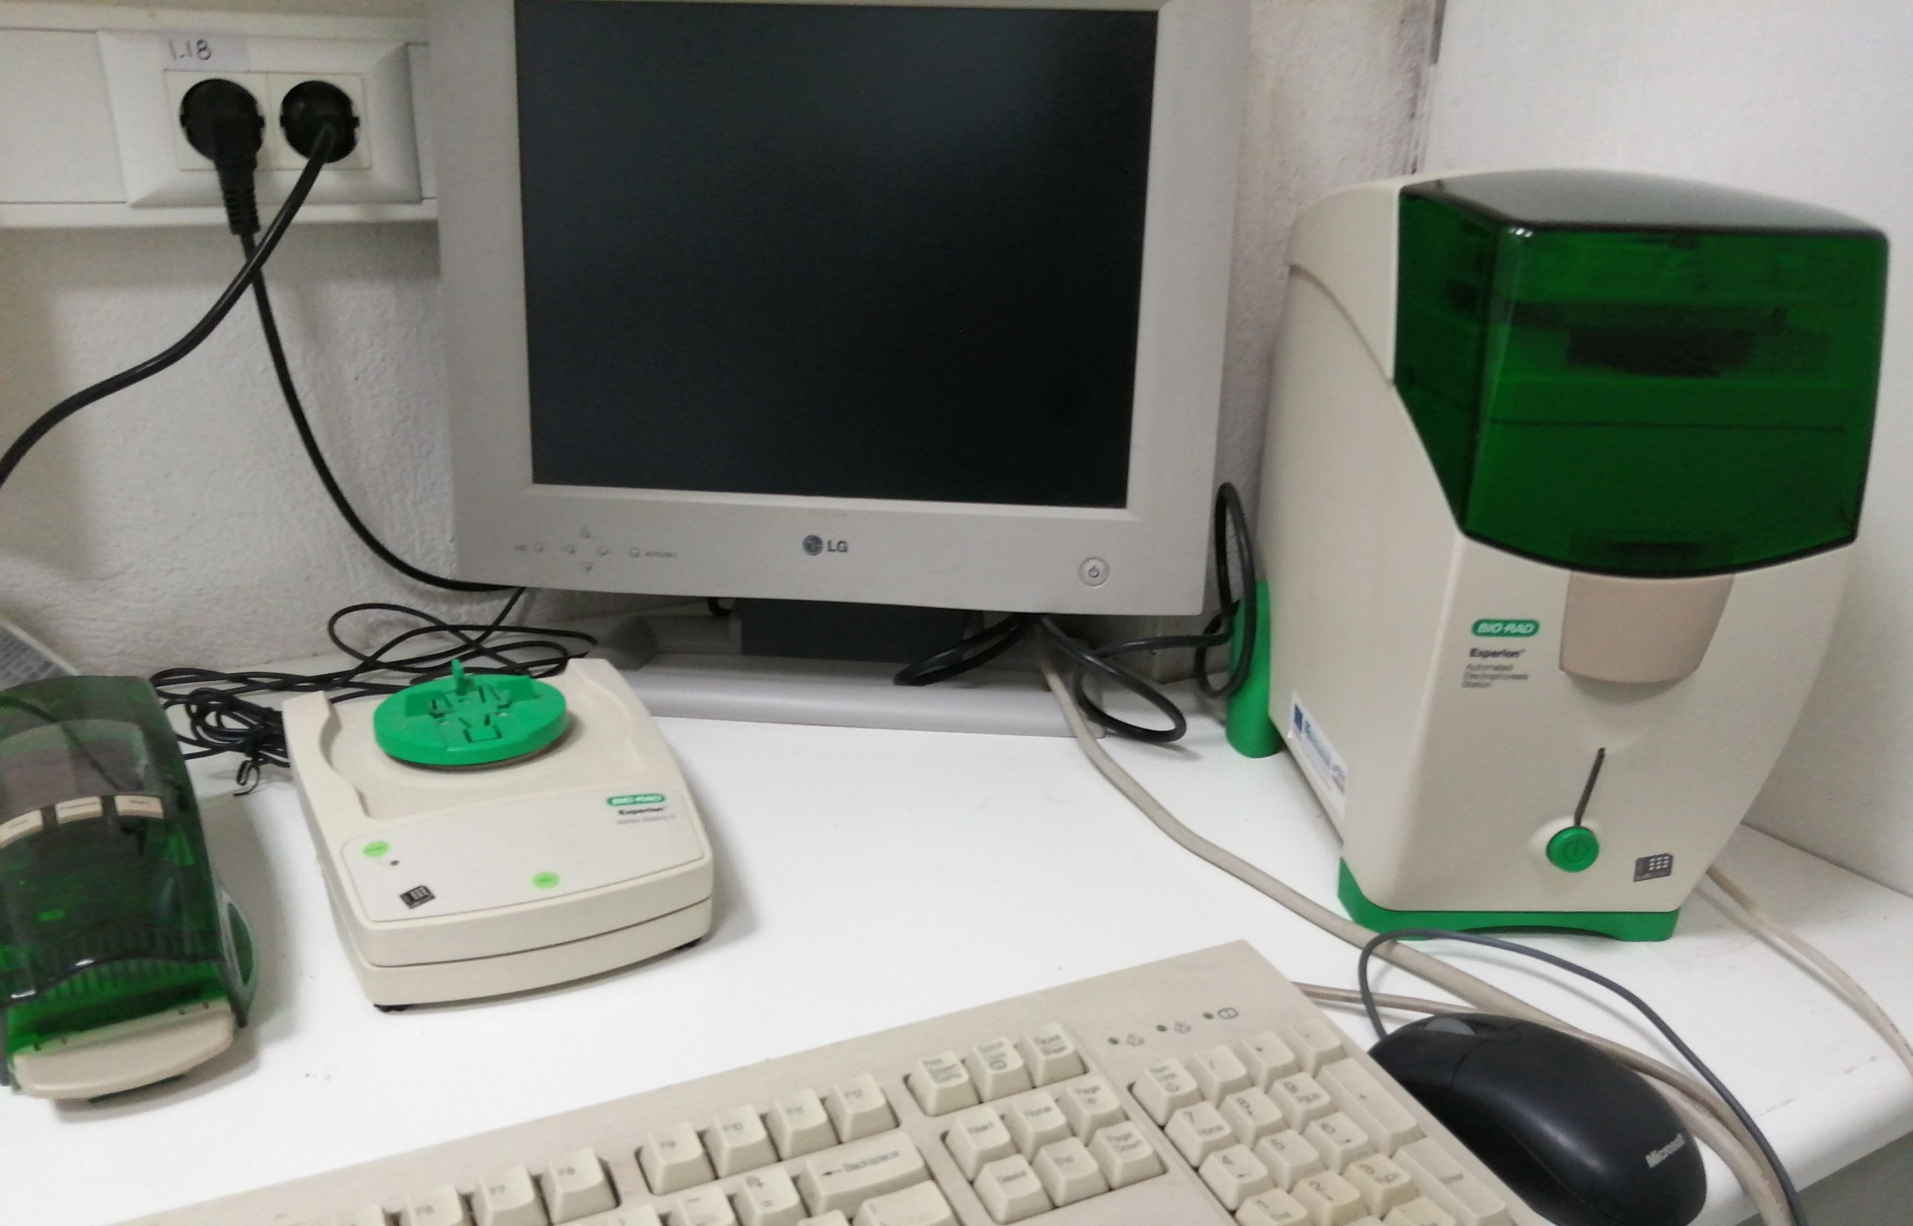
Automated electrophoresis station, ideal for both nucleic acid and protein applications

